Slide 1

Job Search Application
Task - 1

Slide 2


Job Search Application
In this web application we redefine the art of finding the perfect job, transforming the daunting task of job hunting into an empowering and personalized experience.
Our web app will save time, reduce stress, and focus on what truly matters ,finding the career path that excites and fulfills the users.
LMS Username | Name | Batch
au910020104007 | ARULSELVAN M | CC2
au910020104009 | ARUN KUMAR M | CC2
au910020104024 | LAKSHMI BHARATHI A | CC2
au910020104701 | ROHITH M G | CC2

Slide 3

Task - 1
Creation of SRS & Github
Create SRS : “Your Project”
Creation & Set-up of Github account
Creation & Hands-on to various commands of Git Bash
Evaluation Metric:
100% Completion of the above tasks
Learning Outcome
Get to know about different lifecycle models.
Understanding importance and how to create an SRS
Knowing various commands of Github
Understanding agile and scrum management techniques for efficient product development

Slide 4
Step-Wise Description
Project Setup: Create a new React project using Create React App ,Set up the necessary development environment and tools.
Information Architecture: A robust structure is essential, organizing vast data, including job listings, candidate profiles, and company details, for efficient navigation.
Frontend Technologies (HTML/CSS): HTML and CSS form the frontend, creating the visual interface for users to explore job listings and personalized recommendations.
Mobile Responsiveness: A responsive design ensures accessibility across various devices, catering to the increasing trend of mobile job searches.
Backend Technologies (Java): Java, a robust backend language, powers server-side logic, managing data storage, retrieval, and core business processes
Security Measures: Robust security protocols are essential to safeguard sensitive user and company data, building trust among users and employers.

Slide 5
Summary of our Application
Build a user-friendly job search application using HTML/CSS for the frontend and Java for the backend. Design an intuitive interface with personalized recommendations based on user profiles. Incorporate insightful company culture details, prioritize mobile responsiveness, and implement robust security measures. Ensure global compatibility and adaptability to evolving trends, offering a streamlined and secure job search experience.

Slide 6



Assessment Parameter
Gather requirements for the project
add Readme.md file with description of the project
Prepare database design schemas
Check-List
Commit all changes with "first commit"
Get your initial project Structure ready
create a repository on github related to project
Initiate a git repository
Push your changes to github

Slide 7
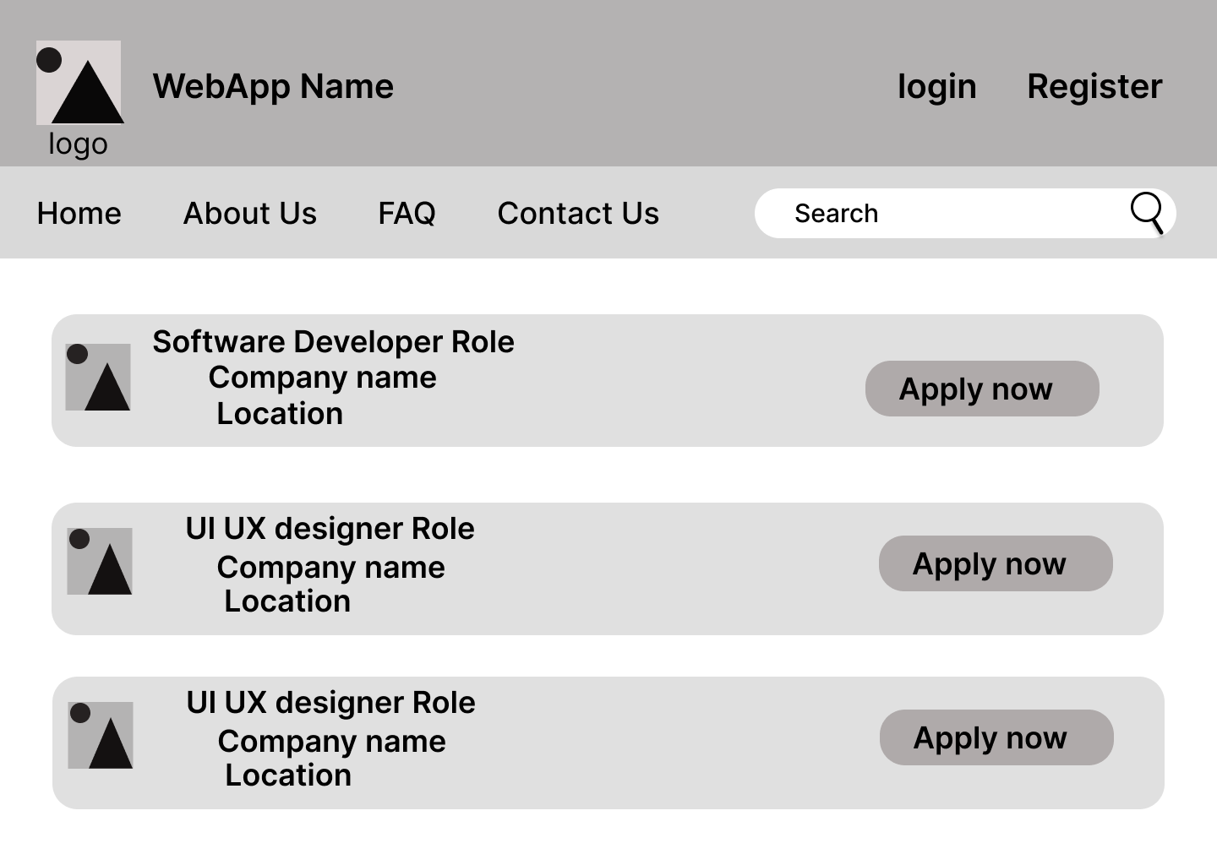
UI OF OUR PAGE

Slide 8


Submission Github
https://github.com/arulselvan-dev/Job_Searching_WebApp.git

Slide 9


